Slide 1
Mail Simulation Application Development
BY :
Afreen M Naikwadi
Sumit sinha
Gajendra singh
Thondamala Likhitha
C.Karthik
Kavya R

Slide 2
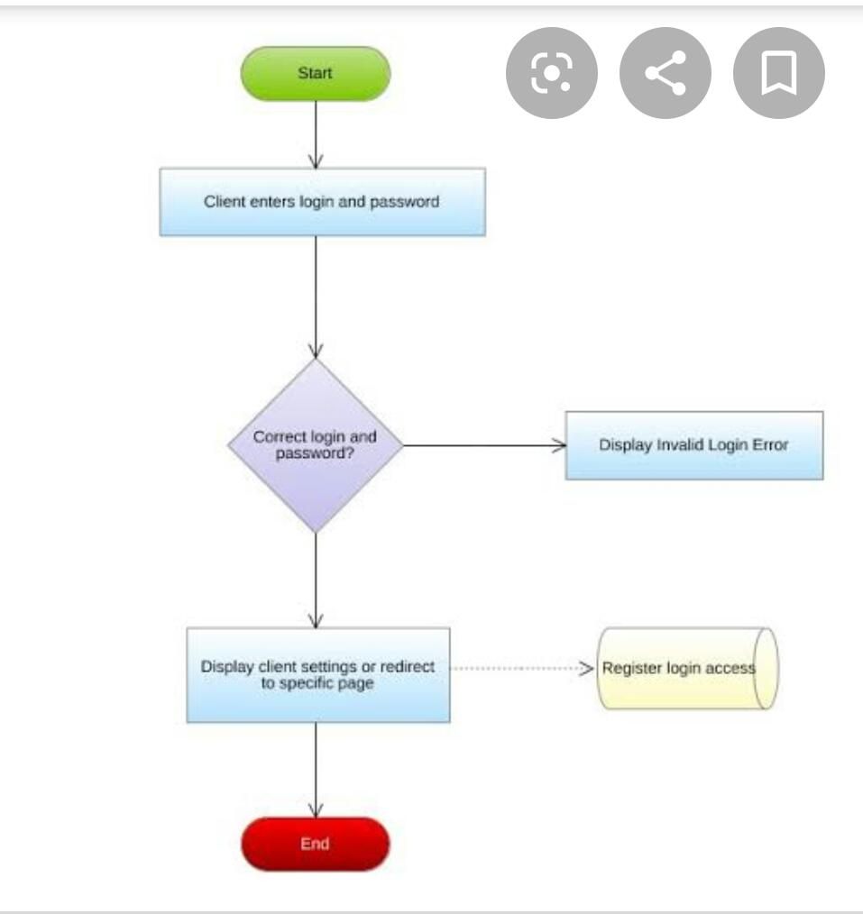
FlowChart

Slide 3
1 Problem Statement
People use to communicate through letters and telegram which is not faster . So mailing system got introduced to over come this problem .
Mail Simulation Application is an application where user can interact with each other through mail .

Slide 4
1.1 Objective
To simulate mailing system so users can communicate easily . This application will have users and those users can communicate through mail .
This will reduce time and increase efficiency

Slide 5
2 Technology And Tools
Technologies
Backend
Spring Boot With Hibernate
Frontend
Angular 7.0
Tools
Eclipse IDE 2019-09
Visual Studio Code

Slide 6
5 Modules
Register
Login
Change password
Sent Mail
Compose Mail
Inbox
Delete
Draft
Home

Slide 7
Roles
Gajendra singh : Back end Login , Register , Forget Password
Sumit Sinha: Front end login , register , Forget Password
Afreen M Naikwadi : Back end and front end Compose mail module
Kavya R : Back end and front end inbox module
C.Karthik: Back end and front end draft , sent mail
Thondamala Likhitha : Back end and front end delete , home modules

